Slide 1
Integrated APC-GAN and AttuNet framework for automated pavement crack pixel-level segmentation: A new solution to small training datasets
Comprehensive Exam
by
Tianjie Zhang
Committee Members
Yang Lu, Ph.D.
Tim Andersen, Ph.D.
Eric Henderson, Ph.D.
Mahmood Mamivand, Ph.D.
November 17, 2022
Notes:
Thanks advisory committee, other faculty, guests, and students.

Slide 2
Emphasis Area: Data Science
Background and Motivation
Research Goals
Proposed Research
Methodology
Preliminary Results
Notes:
Speak out all points

Slide 3
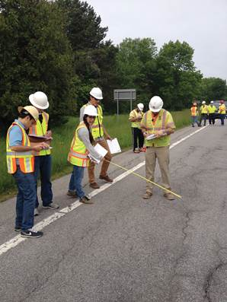
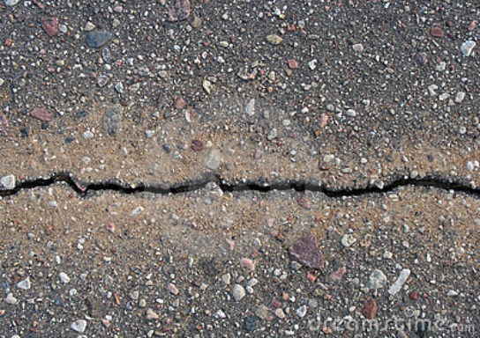
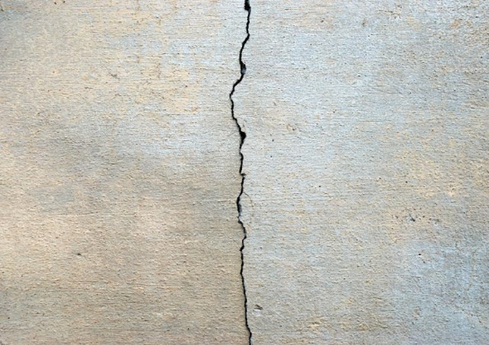
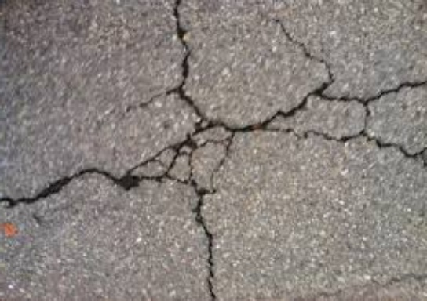
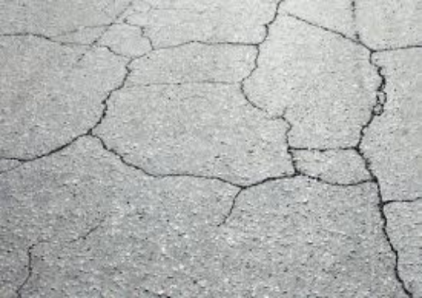
Introduction
Crack has become one of the primary defects in pavement, which seriously affects the service life of pavement.
Traditional inspection:
Cons:
Time-consuming
Labor-intensive
Dangerous
Affect Traffic Flow
Pavement Crack
From: Deep Crack
From:https://www.fhwa.dot.gov/publications/research/infrastructure/pavements/ltpp/15049/007.cfm
Notes:
First, let me introduce the background of this project.
There are several different pavement distresses, such as various cracks, patching, sealing, that occur over the course of a pavement’s service life and can negatively impact the performance and longevity of the structure lifespan. These distresses can occur as a result of loading, environmental conditions, chemicals, and materials used.
The traditional method to determine the number, type, and distribution of defects is often achieved by engineers identifying and counting them manually. However, this method is time consuming, labor intensive and also sometimes dangerous, as it affects the traffic.
A promising new field of interdisciplinary work with computer science being applied to the civil engineering industry, is intelligent pavement defect inspection and identification. If this method is implemented correctly, it could be utilized to identify pavement defects, the severity of the distress, and implement repairs; all through nondestructive methods.

Slide 4

Introduction
Intelligent pavement detection
and identification becomes a significant task.
The training dataset is lacking or uneven, making it insufficient to train an accurate segmentation model.
From: https://www.surveylegend.com/customer-insight/open-ended-survey-questions/
Notes:
First, let me introduce the background of this project.
There are several different pavement distresses, such as various cracks, patching, sealing, that occur over the course of a pavement’s service life and can negatively impact the performance and longevity of the structure lifespan. These distresses can occur as a result of loading, environmental conditions, chemicals, and materials used.
The traditional method to determine the number, type, and distribution of defects is often achieved by engineers identifying and counting them manually. However, this method is time consuming, labor intensive and also sometimes dangerous, as it affects the traffic.
A promising new field of interdisciplinary work with computer science being applied to the civil engineering industry, is intelligent pavement defect inspection and identification. If this method is implemented correctly, it could be utilized to identify pavement defects, the severity of the distress, and implement repairs; all through nondestructive methods.

Slide 5
Introduction
Data augmentation
Network Structure
Crop, Flip, Adjust brightness, contrast, blur…
Trad image-Aug
In 2014, Goodfellow proposed the concept of generative adversarial networks (GANs), which can produce real-like images through a battle between a generator and discriminator.
GAN
Alec Radford proposed deep convolutional generative adversarial networks (DCGANs) based on the conception of GAN, and it showed good representations of images.
DCGAN

Slide 6
Introduction
Data augmentation
Network Structure
Bang, S et al. used ResNet-152 to increase the layers in structure in purpose of increasing the accuracy of cracks identification.
Resnet
The main idea of U-Net is to replace pooling operators by upsampling operators to increase the output resolution. Also, it combines the high-resolution features with the upsampled output to learn more precise information based on small dataset.
U-Net
Notes:
First, let me introduce the background of this project.
There are several different pavement distresses, such as various cracks, patching, sealing, that occur over the course of a pavement’s service life and can negatively impact the performance and longevity of the structure lifespan. These distresses can occur as a result of loading, environmental conditions, chemicals, and materials used.
The traditional method to determine the number, type, and distribution of defects is often achieved by engineers identifying and counting them manually. However, this method is time consuming, labor intensive and also sometimes dangerous, as it affects the traffic.
A promising new field of interdisciplinary work with computer science being applied to the civil engineering industry, is intelligent pavement defect inspection and identification. If this method is implemented correctly, it could be utilized to identify pavement defects, the severity of the distress, and implement repairs; all through nondestructive methods.

Slide 7
Introduction
This paper proposed a framework for pavement crack segmentation which contains an automated pavement crack generative adversarial network (APC-GAN) and a new pixel-level pavement crack segmentation network, AttuNet.
Notes:
First, let me introduce the background of this project.
There are several different pavement distresses, such as various cracks, patching, sealing, that occur over the course of a pavement’s service life and can negatively impact the performance and longevity of the structure lifespan. These distresses can occur as a result of loading, environmental conditions, chemicals, and materials used.
The traditional method to determine the number, type, and distribution of defects is often achieved by engineers identifying and counting them manually. However, this method is time consuming, labor intensive and also sometimes dangerous, as it affects the traffic.
A promising new field of interdisciplinary work with computer science being applied to the civil engineering industry, is intelligent pavement defect inspection and identification. If this method is implemented correctly, it could be utilized to identify pavement defects, the severity of the distress, and implement repairs; all through nondestructive methods.

Slide 8
Data
A DeepCrack dataset was utilized in this work to test the performance of the CNN networks. The DeepCrack dataset is an open-source dataset published in GitHub (https://github.com/yhlleo/DeepCrack).
This dataset consists of 537 RGB crack images with manually annotated segmentations. The image has a resolution of 544 * 384 pixels.
The images are divided into two subsets:
300 images for training
237 images for testing.
Notes:
First, let me introduce the background of this project.
There are several different pavement distresses, such as various cracks, patching, sealing, that occur over the course of a pavement’s service life and can negatively impact the performance and longevity of the structure lifespan. These distresses can occur as a result of loading, environmental conditions, chemicals, and materials used.
The traditional method to determine the number, type, and distribution of defects is often achieved by engineers identifying and counting them manually. However, this method is time consuming, labor intensive and also sometimes dangerous, as it affects the traffic.
A promising new field of interdisciplinary work with computer science being applied to the civil engineering industry, is intelligent pavement defect inspection and identification. If this method is implemented correctly, it could be utilized to identify pavement defects, the severity of the distress, and implement repairs; all through nondestructive methods.

Slide 9
APC-GAN

Slide 10
APC-GAN
The improvements of the APC-GAN compared to the DCGAN:
Large kernel size is used. The kernel size is increased to 4×4 in generator and to 3×3 in discriminator.
The number of convolutional layers is increased.
A batch normalization layer is followed by the convolutional layer.
A Gaussian noise layer is added as the first layer of the discriminator to prevent the discriminator from studying too quick.

Slide 11
APC-GAN
Dataset
Training set
Testing set
Evaluate
Augmentation
Random Crop
+
Deep learning Model
Augmentation comparison
DCGAN
+
APC-GAN
Procedure to evaluate the capacity of APC-GAN

Slide 12
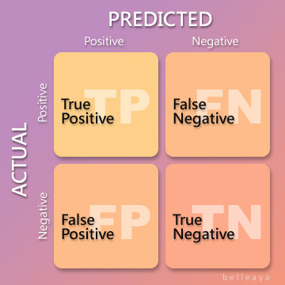
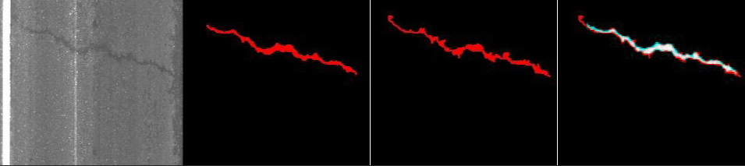
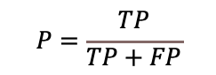
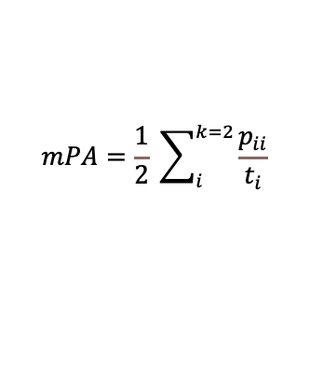
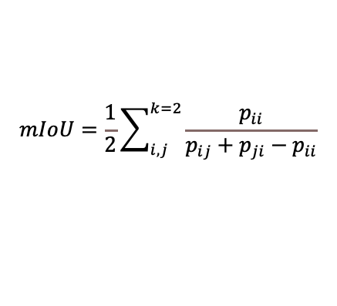
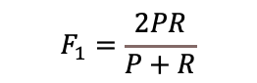
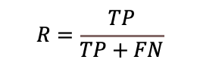
Evaluation metrics
$$P=\frac{TP}{TP+FP}$$
Precision (P) can measure how accurate the predictions are.
$$R=\frac{TP}{TP+FN}$$
Recall (R) suggests the level of sensitivity for prediction results.
$$F_{1}=\frac{2PR}{P+R}$$
F1 is defined based on the harmonic average of Precision and Recall.
$$mIoU=\frac{1}{2}\sum_{i,j}^{k=2}{\frac{p_{ii}}{p_{ij}+p_{ji}−p_{ii}}}$$
IoU measures the overlap between 2 areas.
$$mPA=\frac{1}{2} \sum_{i}^{k=2}{\frac{p_{ii}}{t_{i}}}$$
PA is a semantic segmentation metric that denotes the percentage of pixels that are accurately classified in the image.
Raw image
Prediction
Ground Truth
IoU

Slide 13
APC-GAN
Augmentation results from training set, Random Crop, DCGAN and APC-GAN
Evaluation results
Data | Augmentation | P | R | F1 | mIoU | mPA
DeepCrack | None | 0.950 | 0.839 | 0.892 | 0.812 | 0.839
 | APC-GAN | 0.947 | 0.868 | 0.906 | 0.836 | 0.868
 | DCGAN | 0.949 | 0.851 | 0.897 | 0.822 | 0.851
 | Random Crop | 0.950 | 0.856 | 0.900 | 0.827 | 0.856

Slide 14
AttuNet
Dataset
Training set
Testing set
Deep Learning Models
AttuNet
Evaluate
AttuNet-min
APC-GAN
+
Segmentation comparison
+
U-Net
DeepLab-resnet50
FCN-resnet50
Lraspp_mobilenet_v3_large
Procedure to evaluate the capacity of AttuNet and AttuNet-min

Slide 15
AttuNet
Notes:
First, let me introduce the background of this project.
There are several different pavement distresses, such as various cracks, patching, sealing, that occur over the course of a pavement’s service life and can negatively impact the performance and longevity of the structure lifespan. These distresses can occur as a result of loading, environmental conditions, chemicals, and materials used.
The traditional method to determine the number, type, and distribution of defects is often achieved by engineers identifying and counting them manually. However, this method is time consuming, labor intensive and also sometimes dangerous, as it affects the traffic.
A promising new field of interdisciplinary work with computer science being applied to the civil engineering industry, is intelligent pavement defect inspection and identification. If this method is implemented correctly, it could be utilized to identify pavement defects, the severity of the distress, and implement repairs; all through nondestructive methods.

Slide 16
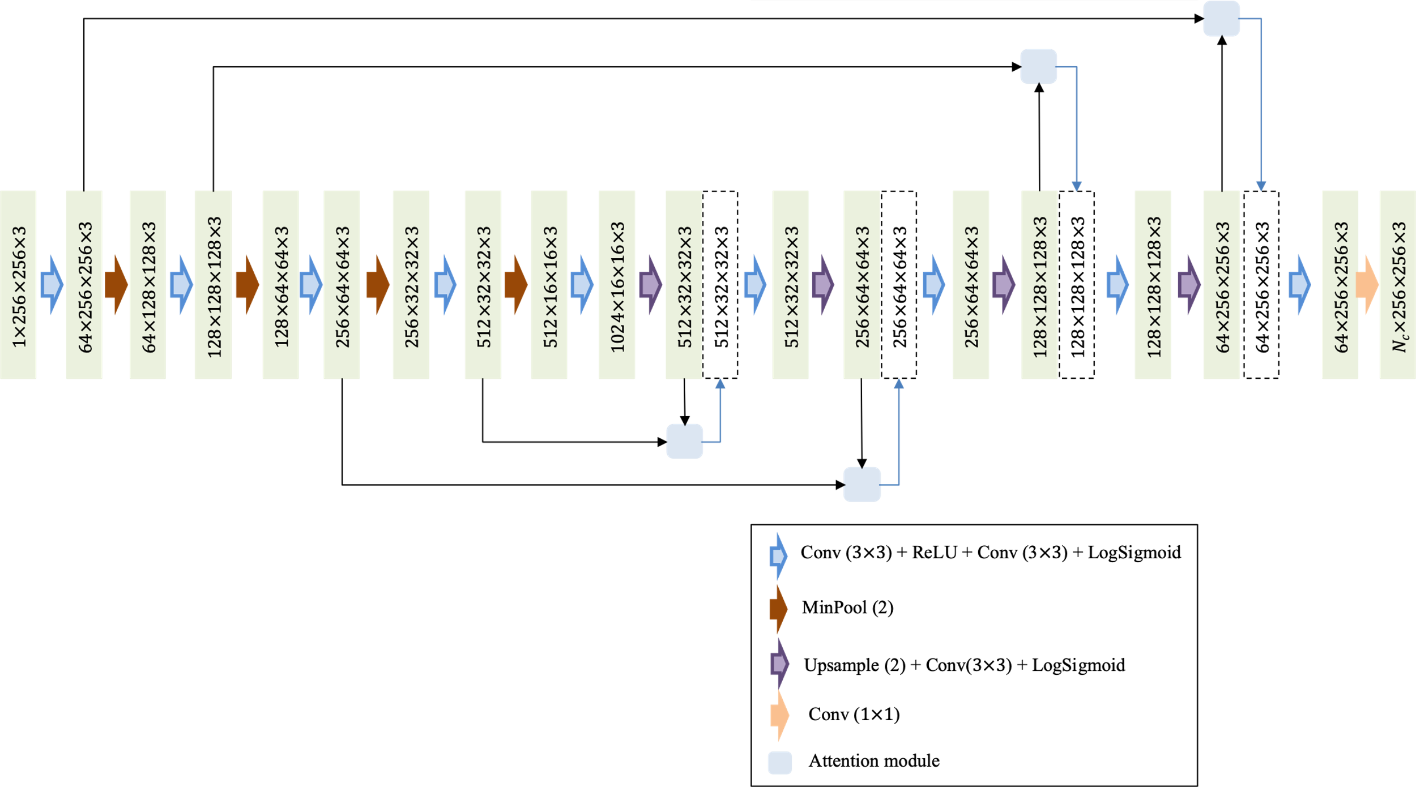
AttuNet-min
The max pooling layer is replaced by the min pooling layer.
The ReLU activation function is replaced by the LogSigmoid function.

Slide 17
AttuNet
Several samples with cracks in various scenes and their segmentation results using different methods:
(a) Original image
(b) Ground Truth
(c) AttuNet
(d) AttuNet_min
(e) U-Net
(f) FCN_resnet50
(g) Deeplabv3_resnet50
(h) LRASPP_mobilenet_v3_large

Slide 18
AttuNet
The results from AttuNet, AttuNet_min and U-Net are more continuous and complete than the segmented results from FCN-resnet50, DeepLab-resnet50 and LRASPP_mobilenet_v3_large.
The segmented part in the red circle shows that the cracks are segmented more entirely by AttuNet_min than by AttuNet and U-Net. It shows that the AttuNet-min has a good performance in the continuous of the cracks as the segmentation image is much closer to the ground truth.

Slide 19
AttuNet
Notes:
First, let me introduce the background of this project.
There are several different pavement distresses, such as various cracks, patching, sealing, that occur over the course of a pavement’s service life and can negatively impact the performance and longevity of the structure lifespan. These distresses can occur as a result of loading, environmental conditions, chemicals, and materials used.
The traditional method to determine the number, type, and distribution of defects is often achieved by engineers identifying and counting them manually. However, this method is time consuming, labor intensive and also sometimes dangerous, as it affects the traffic.
A promising new field of interdisciplinary work with computer science being applied to the civil engineering industry, is intelligent pavement defect inspection and identification. If this method is implemented correctly, it could be utilized to identify pavement defects, the severity of the distress, and implement repairs; all through nondestructive methods.

Slide 20
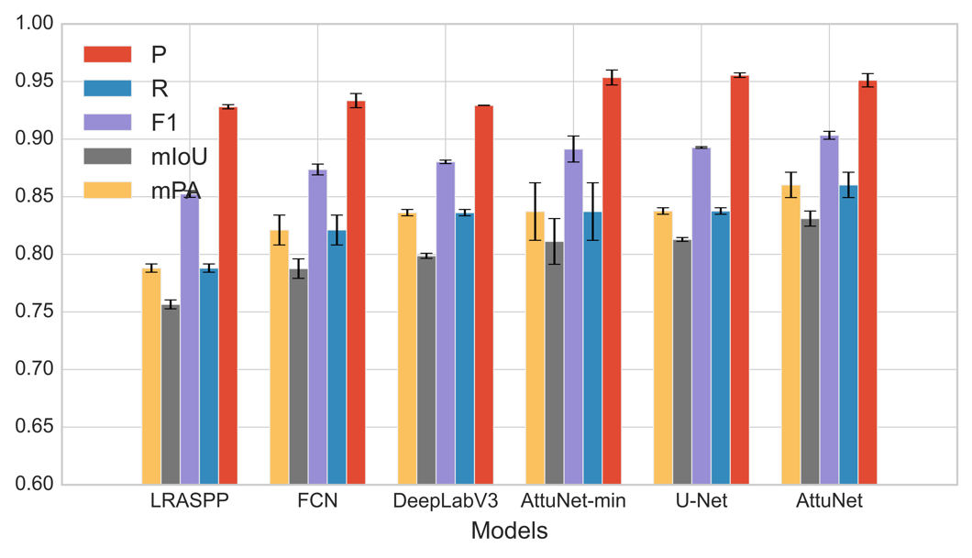
AttuNet
The models in the Figure are ranked by the mIoU from lowest to highest.
It shows that the AttuNet gets the highest mIoU (0.831) among all the models. It also gets the highest value in mPA, followed by AttuNet-min and U-Net, which means that the AttuNet has.
The mIoU and mPA are the two most important indexes showing the segment ability of the method as both of them counted and compared each pixel. A higher value in mIoU and mPA means more pixels were classified accurately.
The AttuNet-min gets the highest precision (0.96) among all CNN models. It means that 96% of the predicted cracks or background are labeled initially as cracks or background.

Slide 21
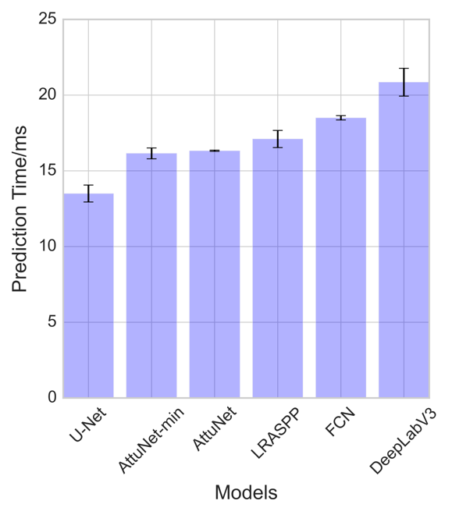
AttuNet
If we want to use the segmentation model in real-time crack detection work, the prediction time per image is an important factor.
A faster prediction time of one model means this model is more suitable for real-time jobs.
As we can see, the U-Net model consumes the least time while the DeepLabv3 consumes the largest time. The mean prediction time of AttuNet and AttuNet-min is 16.32 ms and 16.15 ms, respectively, which perform better than LRASPP, FCN and DeepLabV3.

Slide 22
Conclusion
This paper proposed a novel pixel-level crack segmentation strategy for pavement crack inspection with a small dataset. This situation is very common in road maintenance as the cost of obtaining a large number of pavement top-view images and labeling these manually is very high. However, a small training dataset may cause the neural network overfitting and bad model performance in robustness. The proposed framework consists of APC-GAN and AttuNet, which can accurately segment images with a small dataset.
In this paper, only a total of 300 color images are used for training. The performance of APC-GAN is evaluated and it shows a better ability to produce sharper contrast and more diverse images compared to DCGAN and Random Crop. It improves the recall, F1 score, mIoU and mPA of the segmentation model. The proposed AttuNet model combines the attention module and batch normalization layer with the CNN network. It gets the testing mean IoU (0.831), which is higher than the classic CNN models including U-Net, DeepLabv3, FCN and LRASPP. Compared with AttuNet, the AttuNet-min achieved a more continuous segmentation result by applying the min pooling layer and LogSigmoid activation function.

Slide 23
Publications
Zhang, T.; Rahman, M.A.; Peterson, A.; Lu, Y. Novel Damage Index-Based Rapid Evaluation of Civil Infrastructure Subsurface Defects Using Thermography Analytics. Infrastructures 2022, 7, 55. https://doi.org/10.3390/infrastructures7040055
Behzadian A, Muturi TW, Zhang T, Kim H, Mullins A, Lu Y, Owor NJ, Adu-Gyamfi Y, Buttlar W, Hamed M, Aboah A. The 1st Data Science for Pavements Challenge. arXiv preprint arXiv:2206.04874. 2022 Jun 10.
Submitted manuscripts
Tianjie Zhang, Donglei Wang, Amanda Mullins, Yang Lu. Benchmark Study of Convolutional Neural Networks for Pavement Cracks Classification. International journal of pavement engineering, under review.
Tianjie Zhang, Donglei Wang, Amanda Mullins, Yang Lu. Integrated APC-GAN and AttuNet framework for automated pavement crack pixel-level segmentation: A new solution to small training datasets. IEEE Transactions on Intelligent Transportation Systems. Under review.
Tianjie Zhang, Donglei Wang, Yang Lu. RheologyNet: A New Solution to Predict the Rheology Properties of The Cementitious Materials. Cement and concrete research. Under review.

Slide 24
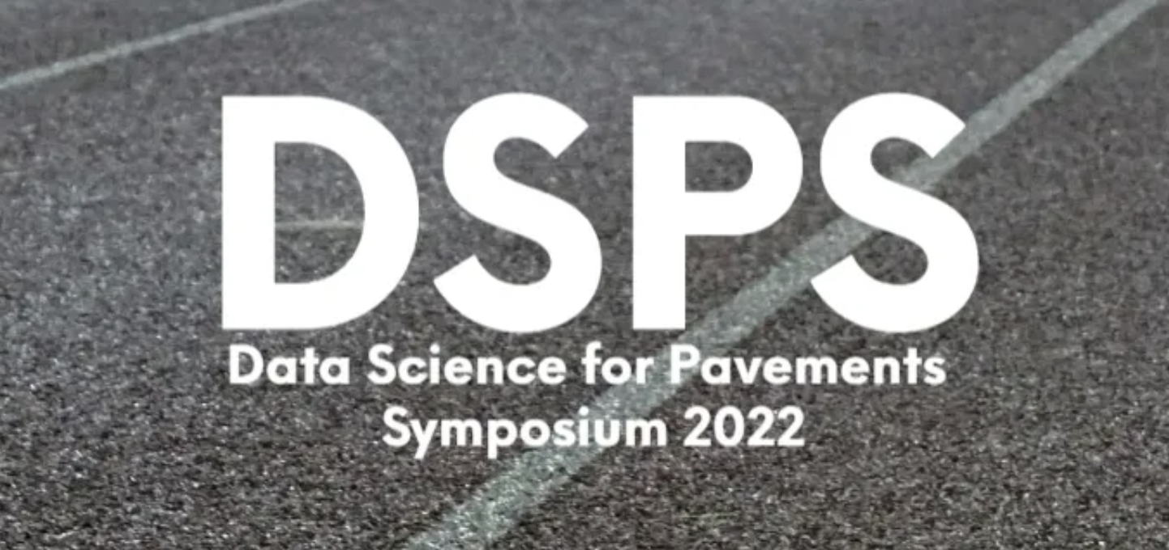

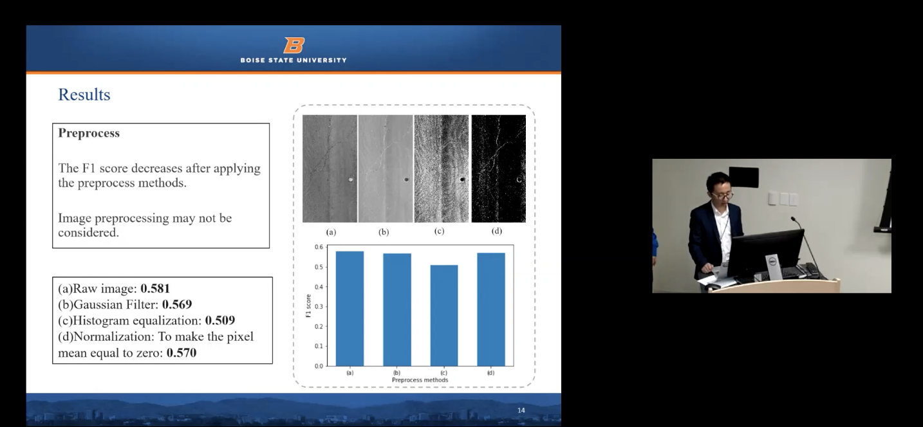
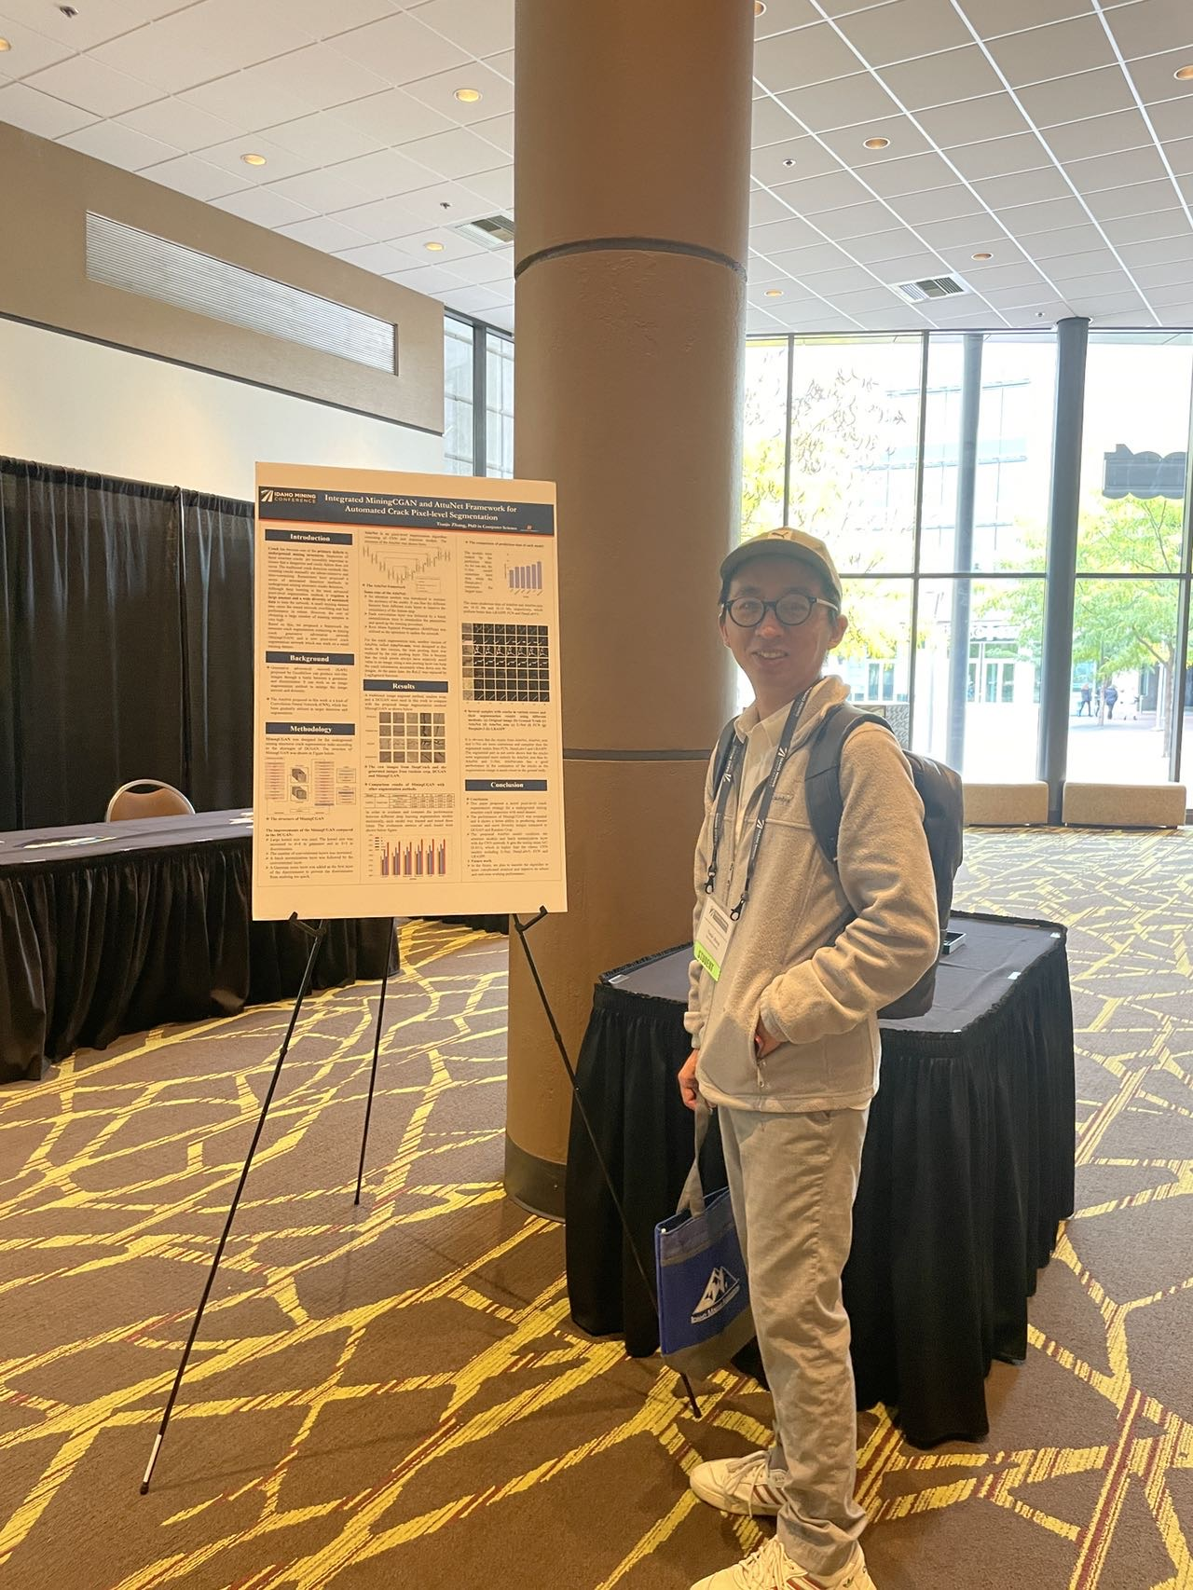
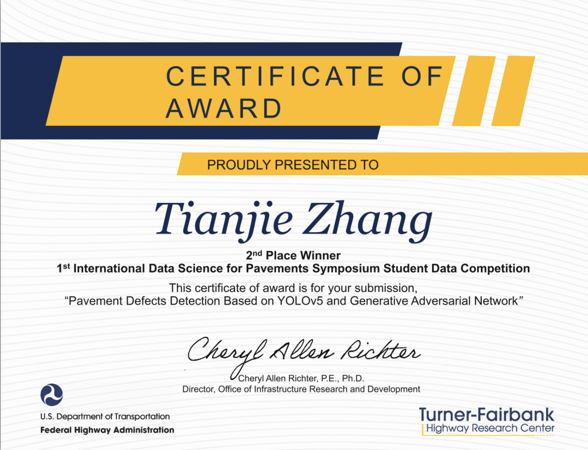
Conference
https://pavementdatascience.com/home
https://idahominingconference.org/

Slide 25
Notes:
Speak out all points

